Slide 1
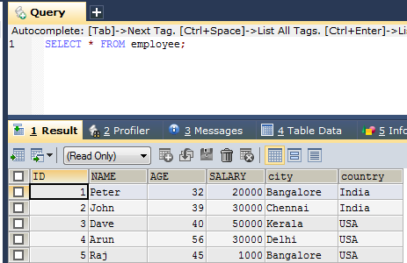
SELECT DISTINCT Examples
The SELECT DISTINCT statement is used to return only distinct (different) values.
Inside a table, a column often contains many duplicate values; and sometimes you only want to list the different (distinct) values.
SELECT DISTINCT column1, column2, ... FROM table_name;
1
2

Slide 2
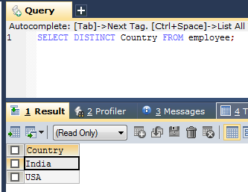
SELECT DISTINCT Examples
The following SQL statement selects only the DISTINCT values from the "Country" column in the “employee" table
SELECT DISTINCT Country FROM employee;

Slide 3
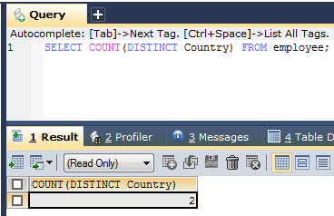
SELECT DISTINCT Examples
The following SQL statement lists the number of different (distinct) employee countries
SELECT COUNT(DISTINCT Country) FROM employee;

